Slide 1
DATA 606 CAPSTONE · FINAL PRESENTATION
Predicting Movie Box-Office
Success Before Release
Bennett Speicher · MPS Data Science, UMBC · Summer 2026
Prepared for the UMBC Data Science Capstone — Dr. Chaojie (Jay) Wang

Slide 2
BACKGROUND
A multi-million-dollar bet, made on incomplete information
Studios commit tens to hundreds of millions of dollars years before a single ticket is sold.
Much of what decides a film's fate — reviews, word of mouth, competition — only appears after release.
But real signals are known beforehand: budget, genre, runtime, release timing, language, studio.
Goal: predict a film's financial success from pre-release attributes alone.
THE DELIVERABLE
An end-to-end pipeline: data → EDA → machine-learning models → an interactive app that scores a film's odds of success.

Slide 3
THE TARGET
What counts as “success”?
Success = Revenue ≥ 2 × Budget
Marketing roughly doubles the cost — studios spend ~50–100% of the budget again on advertising.
Theaters keep about half the box-office gross, so studios net only ~50% of reported revenue.
→ A film must gross about twice its budget just to break even.
56%
of films clear the bar — a balanced target, ideal for classification.

Slide 4
THE DATA
TMDB 5000 Movie Dataset
4,803
3,215
20
1916–2016
movies (raw)
usable after cleaning
original columns
release years
Each row is one movie: budget, revenue, genres, runtime, release date, language, studios.
Cleaning: released films only; plausible budget (≥ $1,000 — 13 films had impossible $1–$250 budgets) and real revenue; parse JSON fields.
Engineered features: ROI, season, release window, genre-timing flags, sequel/franchise flag, major-studio flag.
Source: The Movie Database (TMDb), via Kaggle.

Slide 5
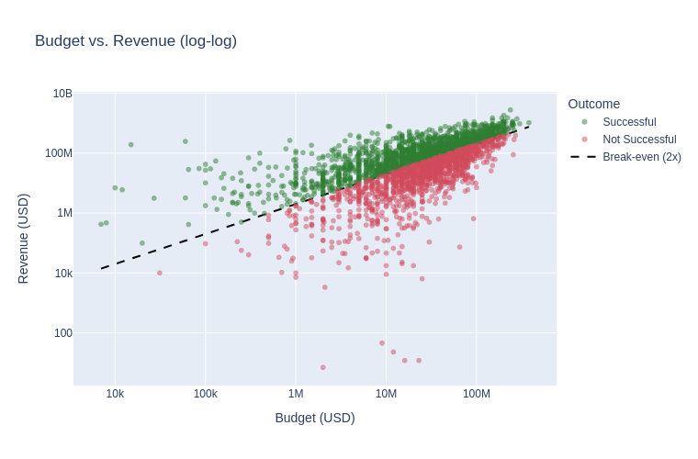
EDA HIGHLIGHTS
Budget vs. revenue — the break-even line
Dashed line = break-even (revenue = 2× budget). Green cleared it; red didn't.
Bigger budgets earn more in absolute terms — but plenty of expensive films still miss.
Budget matters, but it isn't destiny — which is why this is worth modeling.

Slide 6
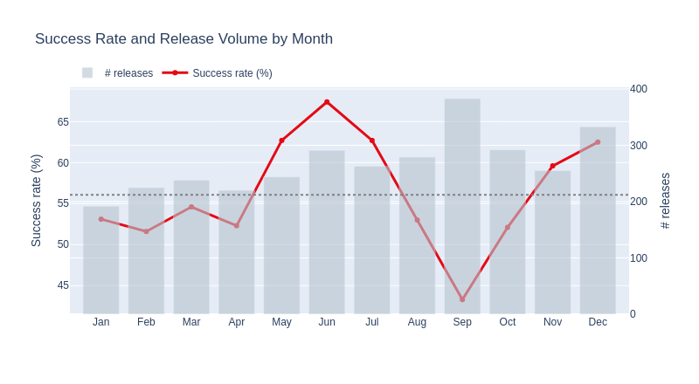
EDA HIGHLIGHTS
When a film opens matters
Success peaks in June (~67%); September is worst (~43%) — and one of the busiest: the “dump month.”
By industry window: Summer and Holiday ~61% vs. 56% baseline; early Fall just 47%.
Genre matters too: horror leads (~78%), action is lowest (~50%).

Slide 7
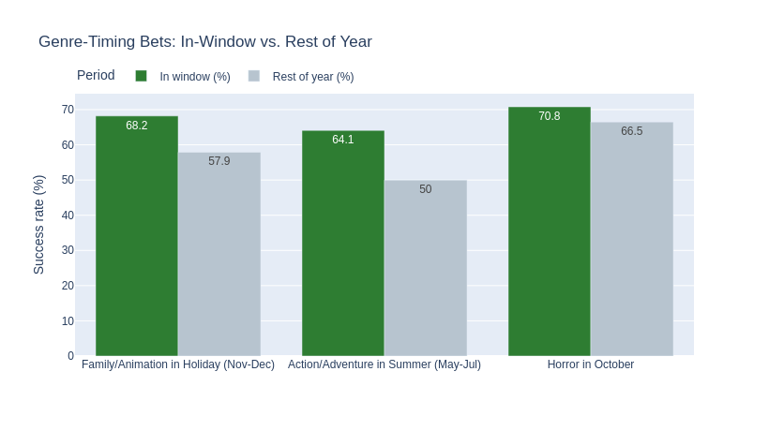
EDA HIGHLIGHTS
The right genre in the right window
Action/Adventure in summer: 64% vs 50% the rest of the year (+14 pts).
Family/Animation over the holidays: 68% vs 58% (+10 pts).
Horror clusters in October — its single biggest release month.
These patterns become features the model can use.

Slide 8
MACHINE LEARNING
Approach — strictly pre-release features, no leakage
16 input features, all knowable before release
Deliberately excluded (leakage)
Financial: budget (log) · spend intensity (budget per minute)
Content: primary genre · runtime · # genres · language(s)
Timing: release year · season · industry release window · genre-timing flags
Production: # production companies · major-studio flag · sequel/franchise flag
Revenue, ROI, profit — the outcome itself.
Popularity, ratings, vote counts — these only exist after release.
The model only sees what a studio would know at the greenlight moment.
Setup: stratified 80/20 train-test split (2,572 / 643 films) + 5-fold cross-validation · three classifiers: Logistic Regression, Random Forest (tuned), Gradient Boosting.

Slide 9
MACHINE LEARNING
Feature engineering — two signals that moved the needle
SEQUEL / FRANCHISE
MAJOR STUDIO
68% vs 54%
61% vs 51%
Detected from plot keywords (sequel, superhero, based on novel…) and title patterns (Part, 2, III…). Franchise films clear the bar far more often.
Whether a major (Disney, Warner Bros., Universal…) produced the film — distribution muscle and marketing reach show up in outcomes.
Also added: release year (era effects) and spend intensity (budget ÷ runtime). Together these lifted test ROC-AUC from 0.66 to 0.71.

Slide 10
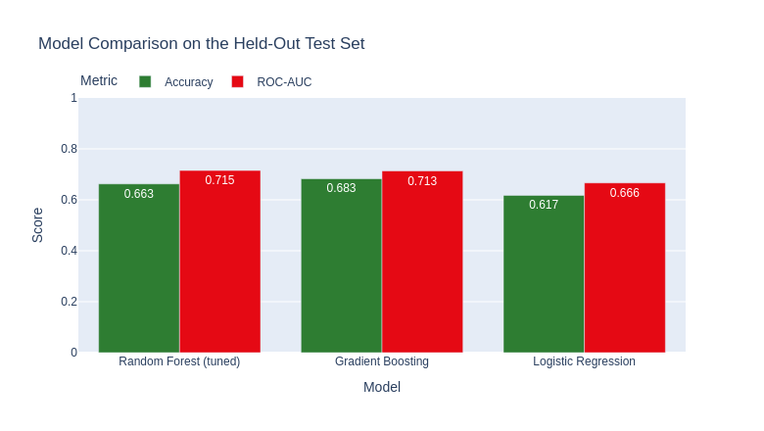
MACHINE LEARNING
Results — all models beat the baseline
Best held-out test: 68% accuracy, 0.715 ROC-AUC (baseline: 56%).
Gradient Boosting and the tuned Random Forest are essentially tied; Logistic Regression trails.
High recall (~0.75): the model catches most true successes.

Slide 11
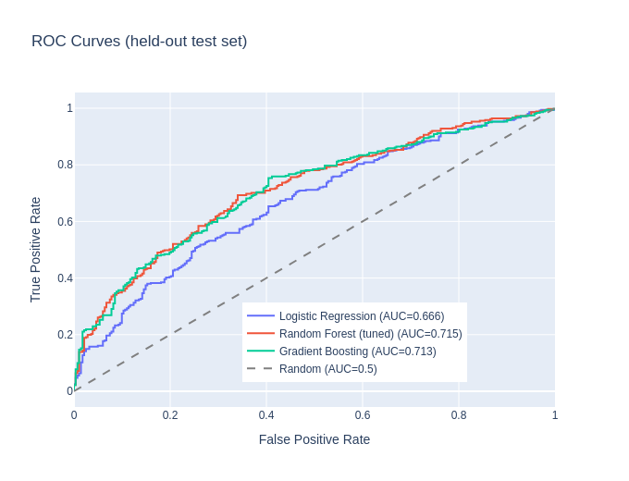
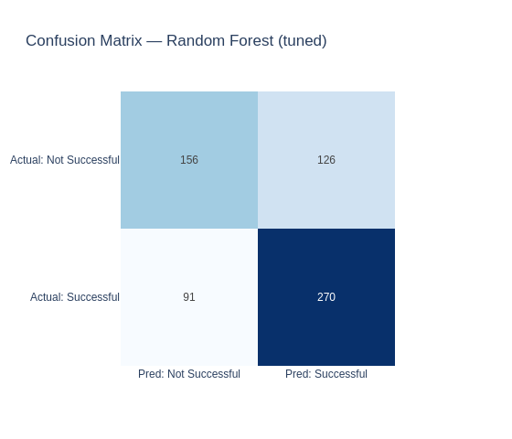
MACHINE LEARNING
Robustness — cross-validation and error profile
5-fold cross-validation: tuned Random Forest is most robust — 64% accuracy, 0.683 AUC (±0.025). A single split can flatter a model; CV keeps us honest.

Slide 12
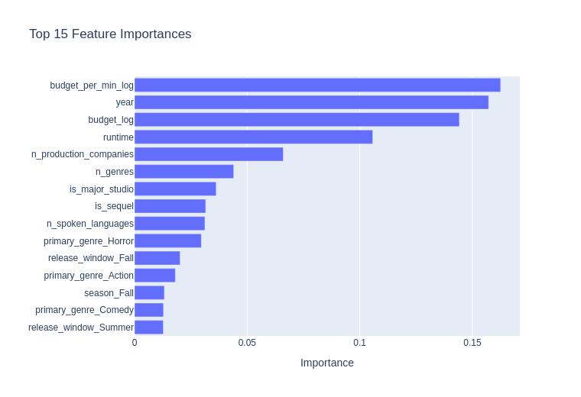
MACHINE LEARNING
What drives the predictions
Financial scale dominates: spend intensity, release year, and budget are the top three.
Runtime, studio count, and the sequel / major-studio flags follow.
Genre (Horror) and the timing features add real secondary signal — the EDA and the model agree.

Slide 13
THE APPLICATION
Streamlit app — every input, explained
What the user enters
What the app does
Budget — the strongest single predictor (log-scaled internally).
Primary genre — horror/animation outperform; action is hardest.
Runtime — also feeds spend intensity (budget ÷ minute).
Release month & year — timing and era effects.
Language · # production companies (+ advanced: # genres, # languages).
Sequel/franchise ✓ and major-studio ✓ — the two engineered flags.
Derives the hidden features automatically — season, release window, genre-timing flags, spend intensity.
Trains the most robust model (tuned Random Forest) on the full cleaned dataset.
Returns a probability of success with a clear verdict — plus the honest caveat that the 2× target is a proxy for profit.
One command to run: streamlit run app/app.py

Slide 14
LIVE DEMO
Movie Box-Office Success Predictor — running locally at localhost:8501
If the demo gods are unkind: summer franchise tentpole → 72% · low-budget October horror → 72% · big-budget September drama → 48%.

Slide 15
CONCLUSION
Takeaways, limitations, and what's next
Takeaways
Limitations
Future work
Pre-release attributes predict success meaningfully better than chance.
Budget dominates; genre, timing, and franchise/studio signals add real lift.
2× rule is a proxy — revenue is gross; budget excludes marketing.
Data ends in 2016 and skews to larger films; ~33% of rows lacked usable financials.
Star power, marketing spend, and competition features.
Newer data + streaming; NLP on plot summaries; ROI-tier prediction.

Slide 16
Predicting movie success
before the cameras roll.
Bennett Speicher · github.com/bdspeicher12/UMBC-DATA606-Capstone
Thank you — questions welcome.

